Slide 1

AR-VR-VE for Computer Science Education 1.0
Team Members: Arelys Alvarez, Samira Tellez, Mairim Barrios, Fidel Hernandez, Carlos Martinez Product Owner: Francisco R. Ortega
Instructor: Masoud Sadjadi School of Computing and Information Sciences Florida International University
Final Presentation
Spring 2018
Notes:
7 seconds.( I will select 2 best slides (i will give them extra points and students will present for CIS committee)
Greet your audience, thank them for attending your presentation, introduce yourself, introduce your project, introduce your team members, and quickly indicate what each of you did in a high-level manner, and put more emphasis on your part/contribution.

Slide 2

Project definition
Notes:
20 seconds.
Introduce the problem that the your project (in new version) tackles with GIF or screenshot.

Slide 3
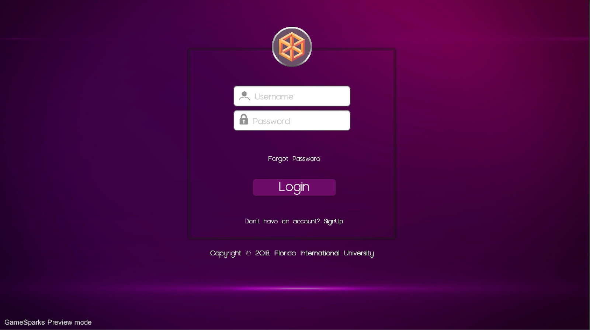
Project definition
Notes:
20 seconds.
Introduce the problem that the your project (in new version) tackles with GIF or screenshot.

Slide 4
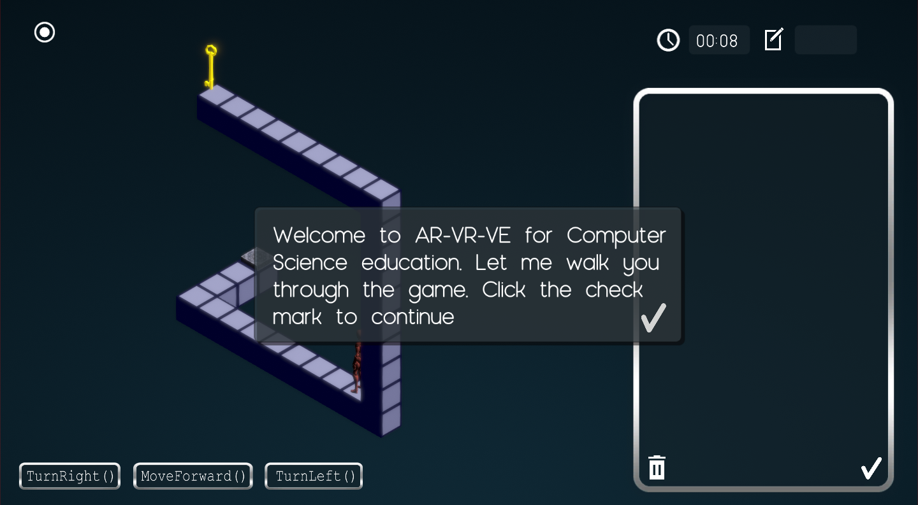
Project definition
Notes:
20 seconds.
Introduce the problem that the your project (in new version) tackles with GIF or screenshot.

Slide 5
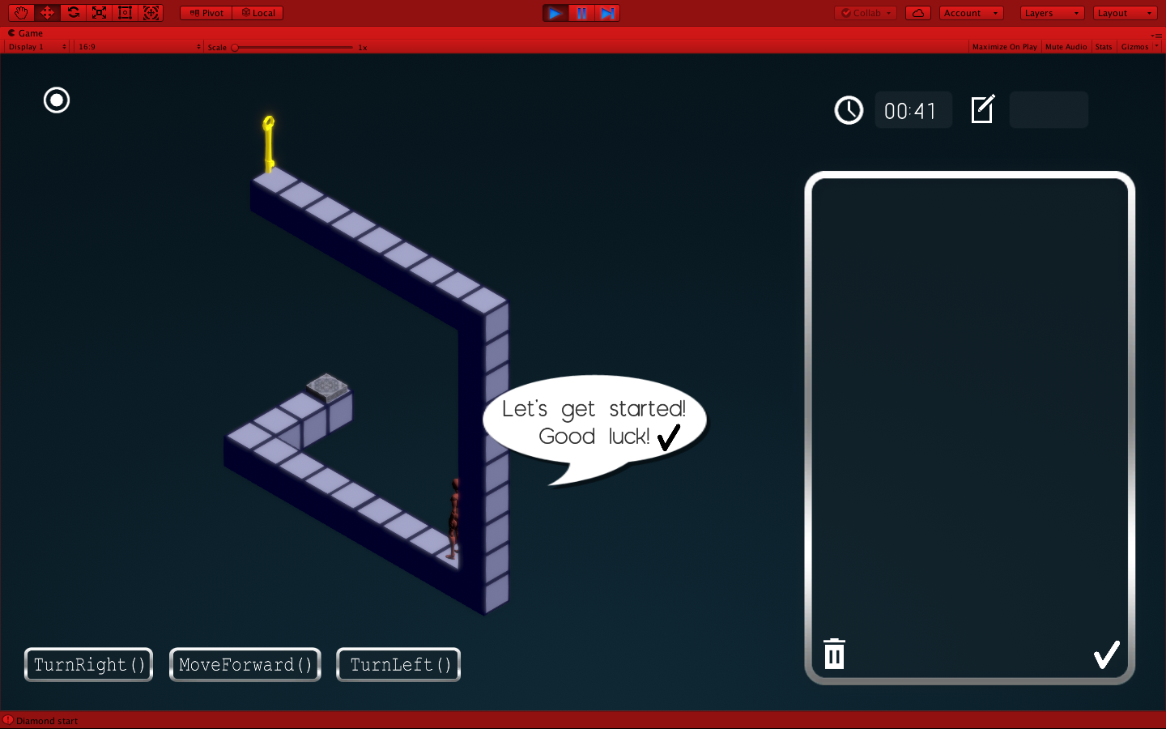
Project definition
Notes:
20 seconds.
Introduce the problem that the your project (in new version) tackles with GIF or screenshot.

Slide 6
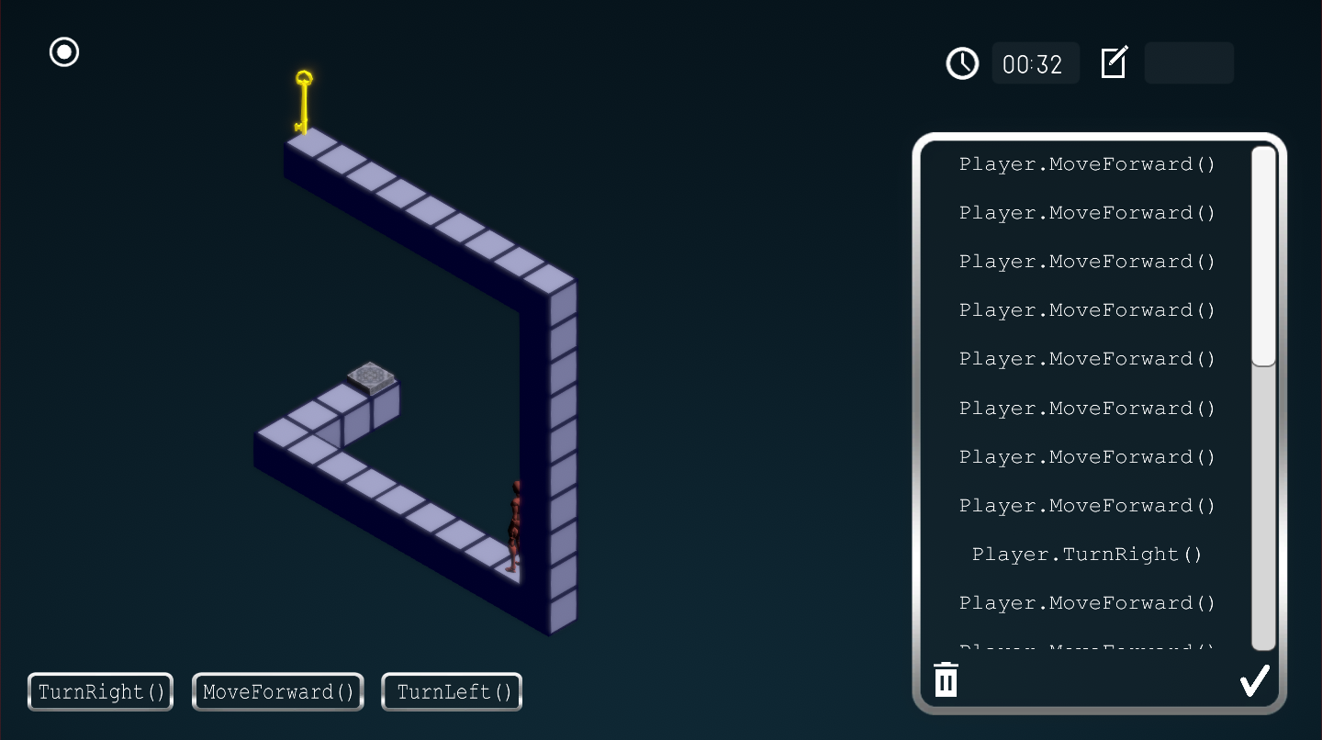
Project definition
Notes:
20 seconds.
Introduce the problem that the your project (in new version) tackles with GIF or screenshot.

Slide 7
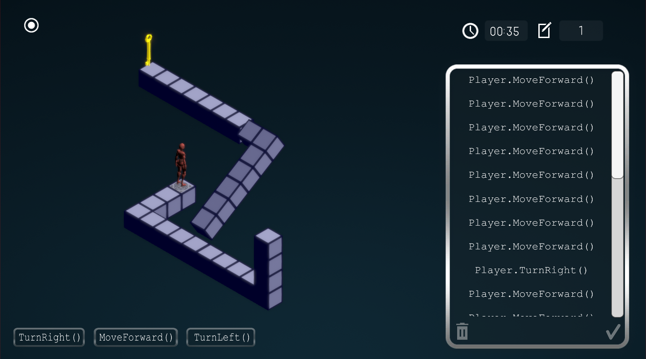
Project definition
Notes:
20 seconds.
Introduce the problem that the your project (in new version) tackles with GIF or screenshot.

Slide 8
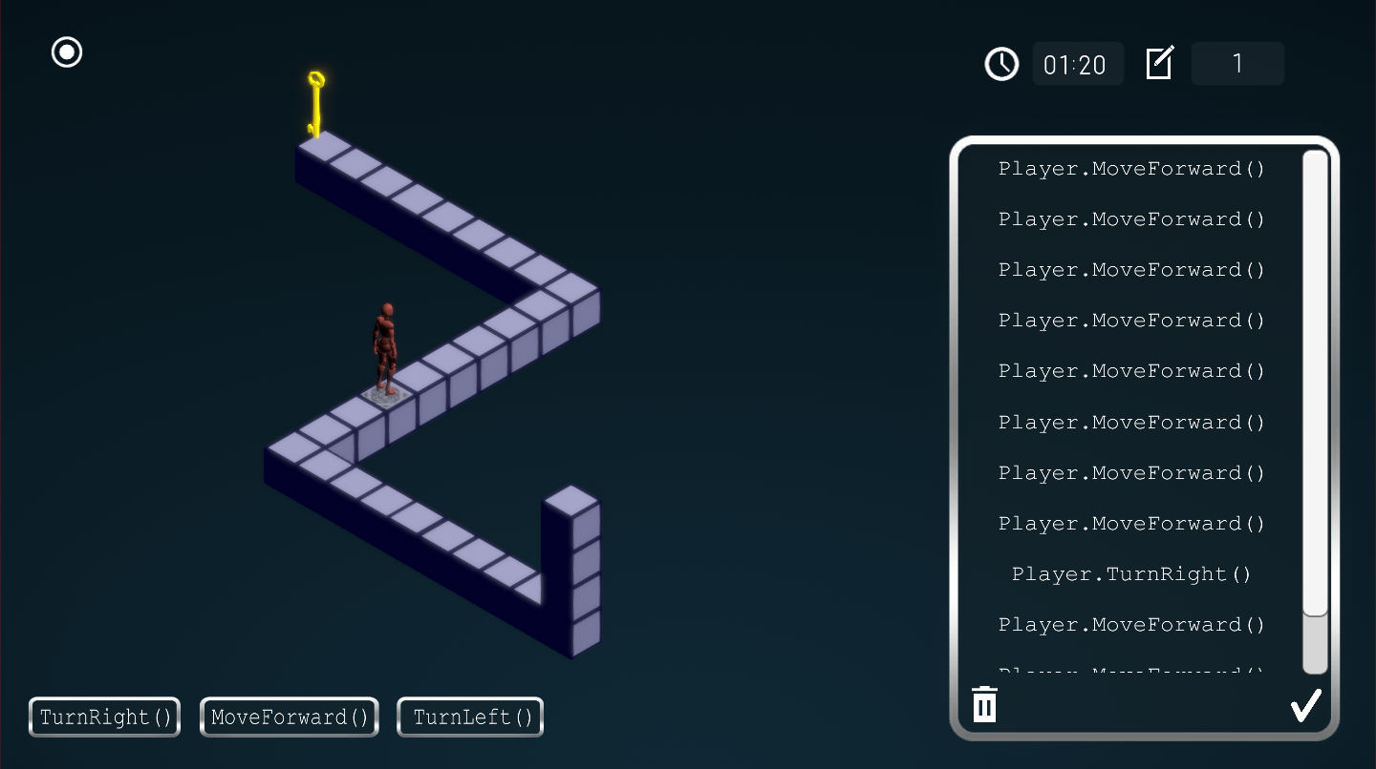
Project definition
Notes:
20 seconds.
Introduce the problem that the your project (in new version) tackles with GIF or screenshot.

Slide 9
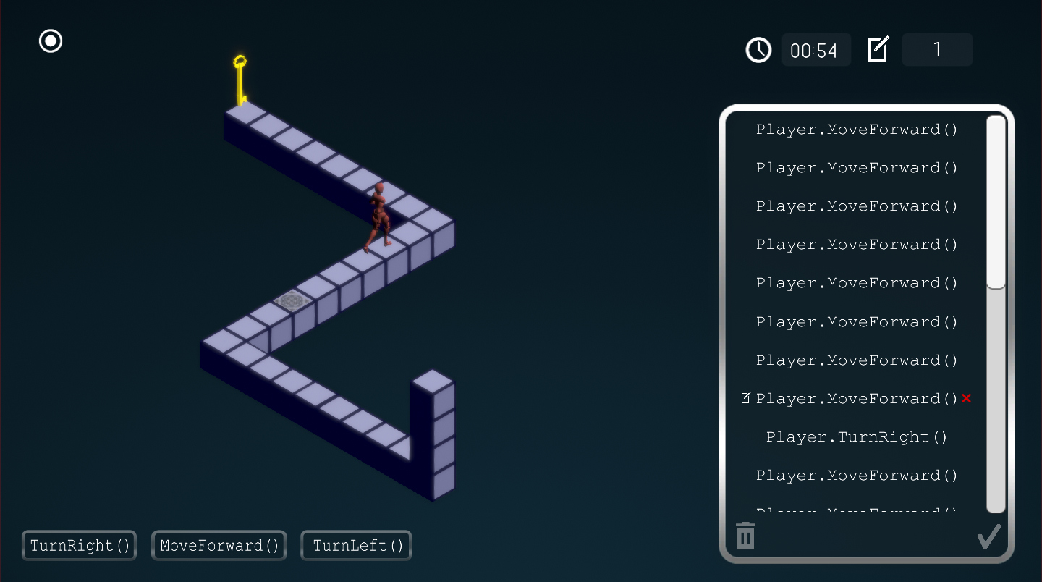
Project definition

Slide 10
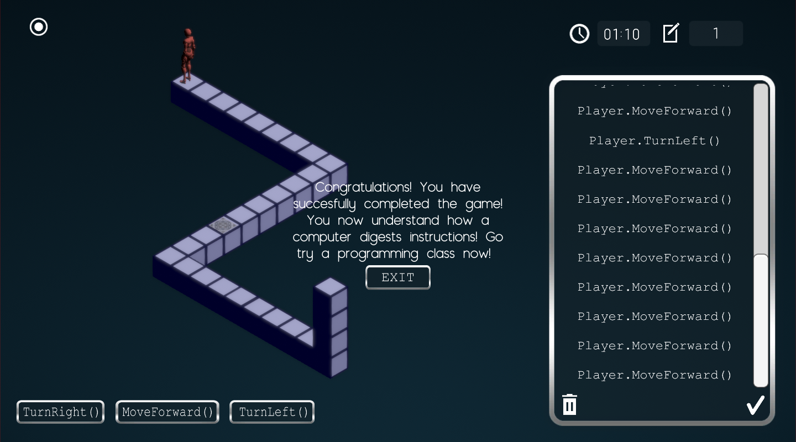
Project definition

Slide 11
System Design: Architecture
System and Subsystem Decomposition
Models
Player: Character that performs the commands
SolutionPanel: Holds the list of commands , loops , editing buttons and scroll rect
Commands (Buttons): Specify the instructions that the player will execute
Notes:
20 seconds
System design: Highlight the parts that you contributed to them.
1. System decomposition; identify the architecture patterns used
2. System deployment – h/w and s/w requirements

Slide 12
System Design: Architecture
System and Subsystem Decomposition. Cont
Controllers
SubmitButtonController : When the submit button within the solution panel is clicked it calls the submitButtonController, which handles the processing of the commands and its execution.
SolutionPanelController: Controls the display of deleteButtons upon hovering of the mouse over a command. Enables/Disables the submit/clear/command buttons while the player is executing instructions.
PlayCommandController: Handles the turning and movement of the character according to the input into the solutionPanel.
BlockRotatorController: Handles the movement of the blocks.
Notes:
20 seconds
System design: Highlight the parts that you contributed to them.
1. System decomposition; identify the architecture patterns used
2. System deployment – h/w and s/w requirements

Slide 13
System Design: Architecture
System and Subsystem Decomposition. Cont
Views
The single Unity Scene that contains the maze, player movement and solution panel is considered the view in this system.
Notes:
20 seconds
System design: Highlight the parts that you contributed to them.
1. System decomposition; identify the architecture patterns used
2. System deployment – h/w and s/w requirements

Slide 14
Test Suites and Test Cases
Test case ID: 1
Description/Summary of Test: Verify that there are a logic flow among the registration scenes
Pre-condition: User begins the registration process on the sign up and/or login forms
Expected Results: SignUp and/or Login forms appear
Actual Result: Status (Fail/Pass): Passed
Notes:
10 seconds
A description of verification process and Test Suites and Test Cases for one of the use cases.
1 One sunny day and one rainy day for the implemented use cases (one or more slides).
2 Automated test scripts for the implemented use cases (if any) (one or more slides).

Slide 15
Test Suites and Test Cases
Test case ID: 2
Description/Summary of Test: Verify and validate users information that when this is wrong, they are notified.
Pre-condition: User enters wrong information
Expected Results: Warning messages shows up
Actual Result: Status (Fail/Pass): Passed
Notes:
10 seconds
A description of verification process and Test Suites and Test Cases for one of the use cases.
1 One sunny day and one rainy day for the implemented use cases (one or more slides).
2 Automated test scripts for the implemented use cases (if any) (one or more slides).

Slide 16
Test Suites and Test Cases
Test case ID: 3
Description/Summary of Test: Add sound tracks as backgrounds and sound effects.
Pre-condition: User starts game and/or enter wrong information in any of the registration forms
Expected Results: Music plays throughout the game. Sound effect tracks are played when wrong information is entered.
Actual Result: Status (Fail/Pass): Passed
Notes:
10 seconds
A description of verification process and Test Suites and Test Cases for one of the use cases.
1 One sunny day and one rainy day for the implemented use cases (one or more slides).
2 Automated test scripts for the implemented use cases (if any) (one or more slides).

Slide 17








Summary
As part of the education process needed to include more people into computer science , the development of this game is a very effective approach. The goal is to bring more young students from colleges in other majors and help finish the women underrepresentation.
stell013@fiu.edu
Thank You!
Notes:
10 seconds
Summarize your contribution, mention your effort for Scrum, Mingle, Github, Google Drive Documentation and minutes
Include your contact information
Ask if anyone has any questions for you.
Thank your audience

